Slide 1

OSFO Workshop
2011 Assembly New Caledonia

Slide 2
Introduction
Today we will be looking at the development of sport in the region from the perspective of the National Federation (NF).
As an outcome from last year’s workshops we concluded that the NF is the common link between the regional stakeholders.
Collectively we will be reviewing this and at the end of our workshop have some ideas on how we can work collaboratively to build NF capacity, by identifying the respective contributions each of the stakeholders can make.

Slide 3
The Stakeholders
IOC
IFs
OSFO
ONOC
National
Federations
ASC
ASC
NOC
Regional Federation
PGC

Slide 4
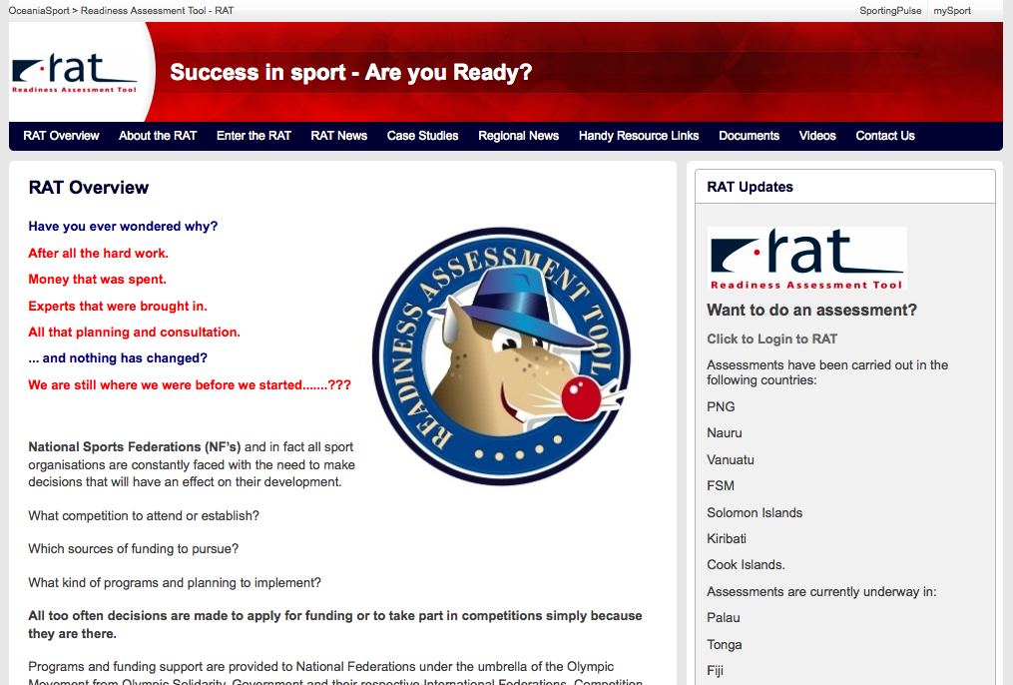
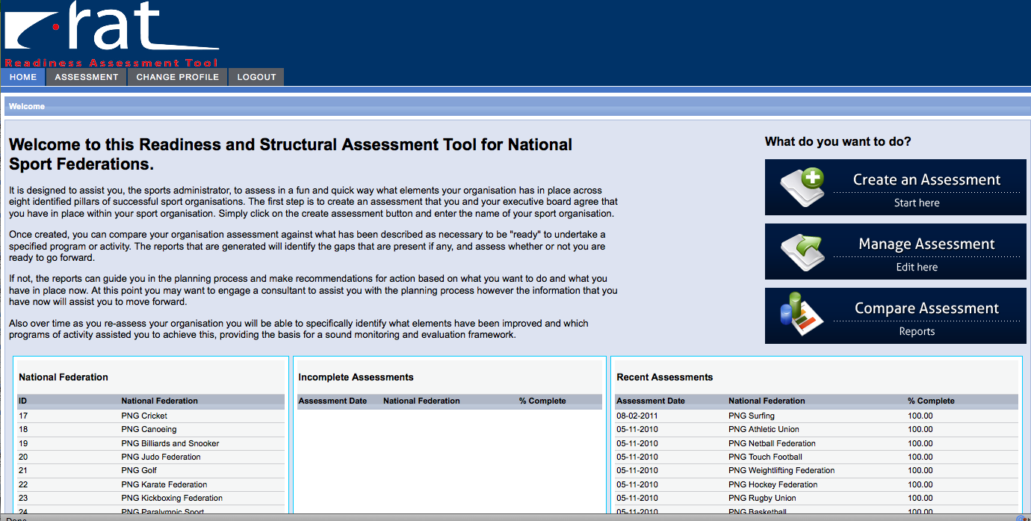
The RAT
Readiness Assessment Tool
Assessments and comparisons
The Website – case studies and how to

Slide 5
Create, Manage and Compare an Assessment

Slide 6
The Pillars
Governance
Management
Sport Activity
Communication
Finance
Physical Resources
Human Resources
Values

Slide 7
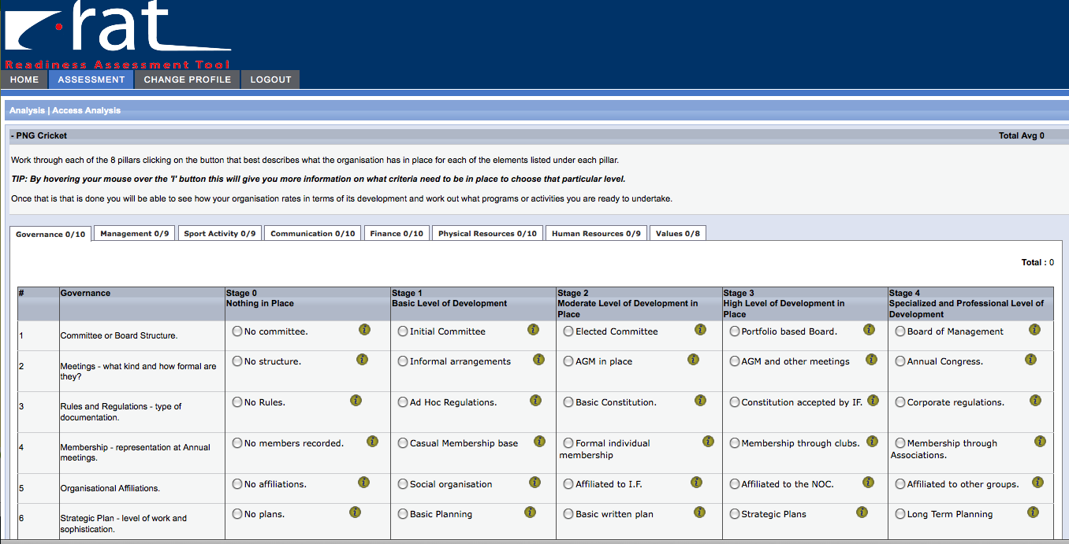
Example Assessment

Slide 8
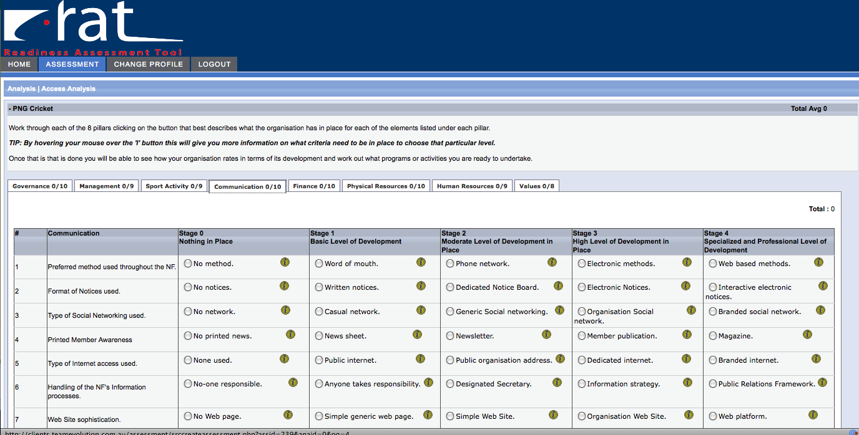
Example Assessment

Slide 9
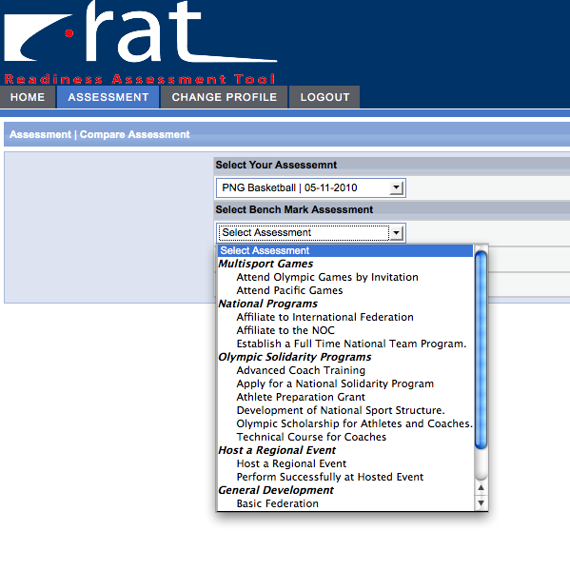
Comparative Assessment
PNG basketball – Development National Sport Structure

Slide 10
Discussion Groups
How would you use this tool within your organisation?
Any potential issues, challenges you think may be faced.

Slide 11
Regional Sport Framework

Slide 12
Discussion Groups
Millie’s questions

Slide 13
Question Time

Slide 14
OSFO’s Response/Next Steps
There is a need for NF capacity building in the region.
Response:
RAT – identifies the gaps in capacity
Sport Framework – delivers the education to “fill the gaps” by drawing on partner contributions

Slide 15
OSFO’s Response/Next Steps
Stakeholders have a unique contribution:
ONOC/NOCs, OSFO/RFs, PGC/Games, ASC/Programs
Response:
We are seeking a collaborative forum to unite partner contributions to facilitate
National Federation capacity building.

Slide 16
The Stakeholders
IOC
IFs
OSFO
ONOC
National
Federations
ASC
ASC
NOC
Regional Federation
PGC

Slide 17
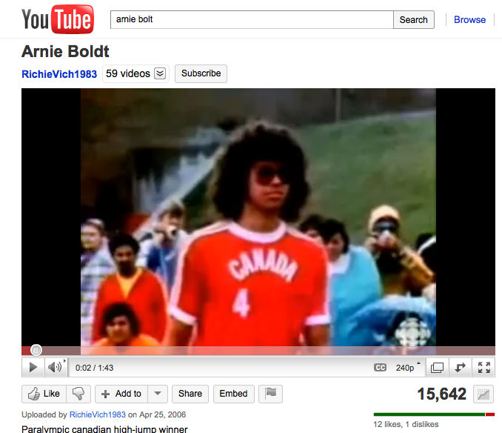
The Challenge
http://www.youtube.com/watch?v=6auGPszgiJA
Let’s raise the bar on our expectations of our National Federations

