Slide 1

IT and sponsorship
Edwina Ricci 2011 OSFO Assembly

Slide 2
Information Technology
ASC provided funds for a communications project
Decision was made to create a regional calendar
Update the content of the OSFO website
Status of project

Slide 3
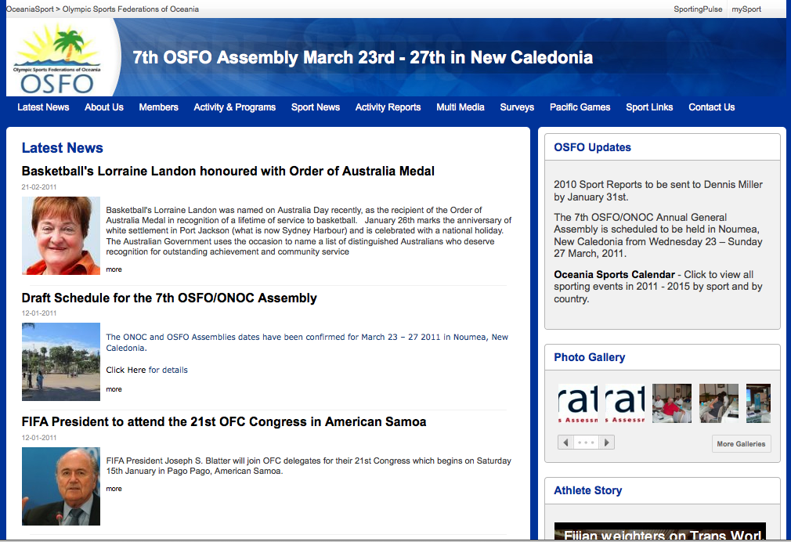

Slide 4



Events
Latest events displayed
Login for Federations to enter own events

Slide 5
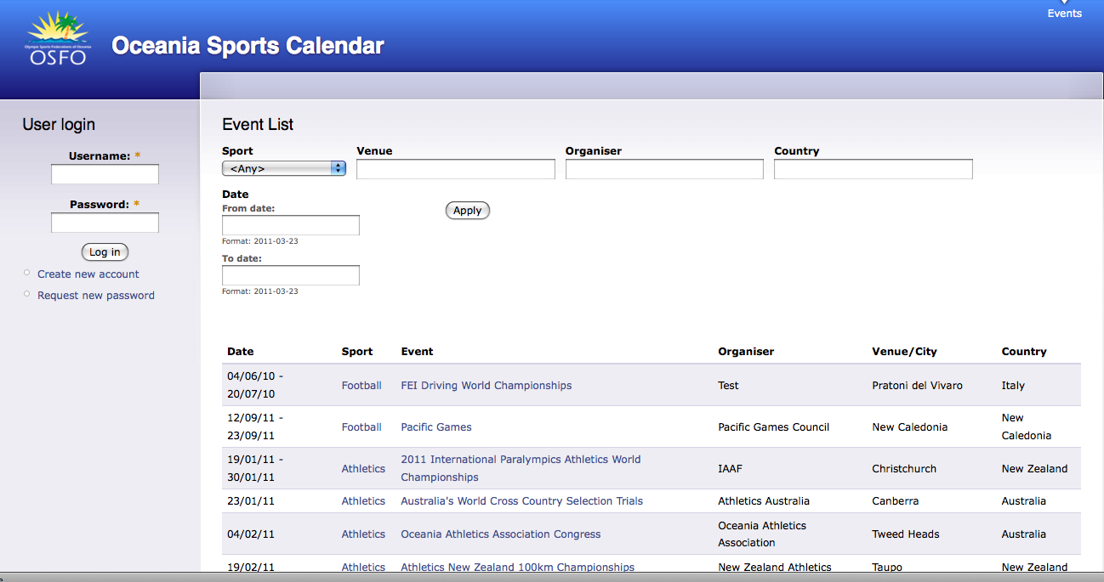

Slide 6
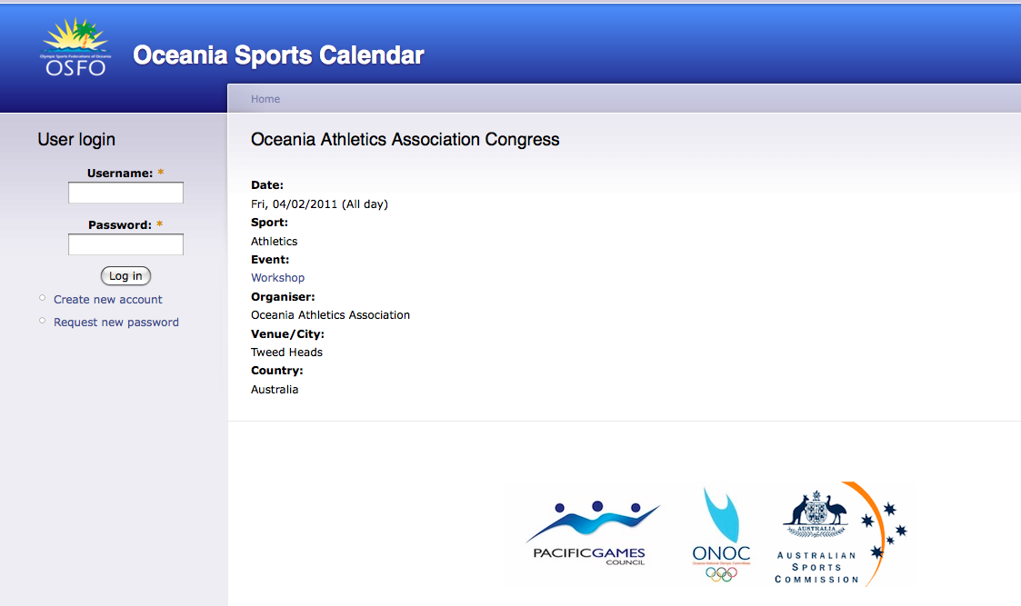
The Individual Event
Image
Website link

Slide 7
What is required of members?
Contact details of at least three members of your federation
Case studies – brief overview of programs you are running in the region
List of regional activities/events for the next 4 years – workshops, events, meetings – spreadsheet will include the information required for each entry
List of your member federations and at least one contact for each.

Slide 8
Sponsorship
Meeting with Jerry Strudwick – Education Aid
Delay due to government shake up
Foreign Minister – Kevin Rudd, Parliamentary Secretary for the Pacific Richard marles
Email
Interest for a meeting
Development of the proposal

Slide 9
Richard Marles Proposal
Fund an OSFO secretariat
Fund National Federation capacity building
Fund the coordination and education of the sport development officers in the region – potential conference at the AIS.
Provide the opportunity for sport to assist other sectors of AID like Education, Health and Youth services
Enable OSFO to support existing programs in the region – Sport Education Framework, Pacific Games, ASOP and PSP.

Slide 10
Next Steps
Round table of government today to discuss sport and aid.
Two High Commissioners have flagged the benefits of sport
Richard Marles will come back to us
We want to discuss more formally our needs.
Our aim is to get the funding for resources for us to spend the time to do the work we know we can to make difference not only in sport development but overall youth development.

Slide 11

New Program
The Reporter’s Academy
Launched in Manchester
Launching Melbourne next week
Launching next in Fiji
Introduce Glyn Maguire

Slide 12
New Program
The Reporter’s Academy Aims
Gives kids, often from disadvantaged background the opportunities to develop skills to equip them for the 21st century – literacy and social competencies
Work beside industry professional
Work on events – Cook Islands
Kids have time to produce content – we need content

Slide 13
Some examples of the work
World Cycling Championships Manchester
http://www.youtube.com/watch?v=QR7HKQriYw8
Launch Video
http://www.youtube.com/watch?v=eVrkcIP4vZQ

